Slide 1


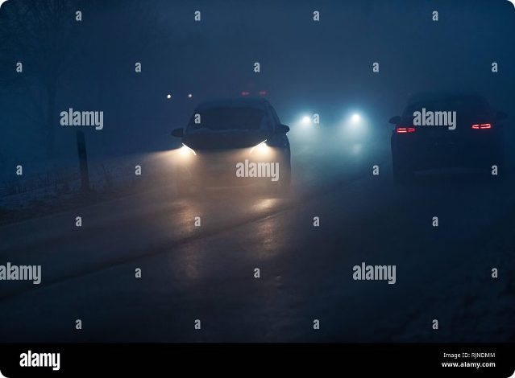

Adaptive Automobile Headlight System
The Adaptive Automobile Headlight System is an innovative project that utilizes an Arduino microcontroller, a photoresistor, and a transistor circuit to automatically adjust the brightness of a vehicle's headlights based on the ambient light conditions. This system aims to enhance road safety by providing optimal illumination for drivers in various lighting environments, from dark roads to well-lit urban areas.

Slide 2

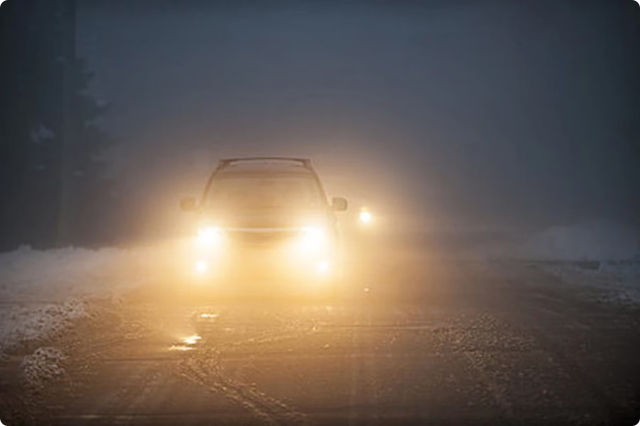
Enhancing Driving Safety
1
Ambient Light Detection
The system uses a photoresistor to continuously monitor the ambient light levels surrounding the vehicle. This sensor provides the Arduino microcontroller with real-time data about the current lighting conditions.
2
Automated Brightness Adjustment
Based on the ambient light readings, the Arduino adjusts the power supplied to the LED headlights through the TIP122 transistor circuit. This ensures that the headlight brightness is optimized for the prevailing lighting conditions, providing drivers with the best possible visibility.
3
Improved Road Visibility
By automatically adapting the headlight intensity, the system helps drivers navigate safely in various lighting environments, reducing the risk of accidents caused by poor visibility. This feature is particularly beneficial in scenarios like driving through tunnels or during sudden weather changes.

Slide 3
Advantages and Customization
Enhanced Safety
Energy Efficiency
Customizable Preferences
The adaptive headlight system improves driving safety by providing optimal illumination tailored to ambient light conditions, reducing the risk of accidents caused by poor visibility.
By adjusting the headlight brightness based on ambient light levels, the system minimizes energy consumption compared to traditional fixed-intensity headlights, contributing to environmental sustainability and reducing fuel consumption.
The system can be easily customized to accommodate preferences for brightness levels and response thresholds, allowing for personalized driving experiences to suit individual needs and preferences.

Slide 4

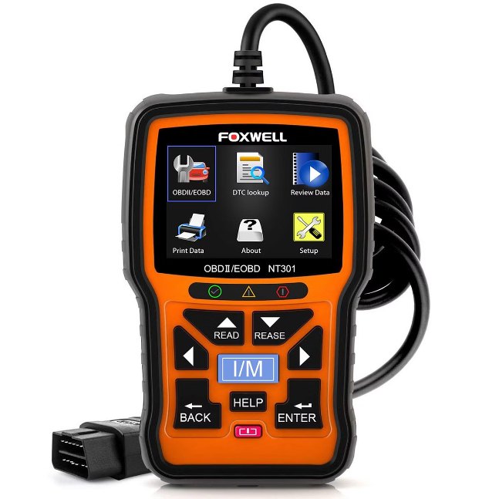
Considerations and Potential Challenges
1
Sensor Accuracy
The accuracy of the ambient light sensor (photoresistor) may vary depending on factors such as environmental conditions, sensor calibration, and component quality. Inaccurate sensor readings could affect the system's ability to adjust the headlight brightness effectively.
2
Maintenance Requirements
The system may require periodic calibration and maintenance to ensure the proper functioning of components and the reliability of light intensity adjustments over time. Regular checks and adjustments may be necessary to address sensor drift or component degradation.

Slide 5

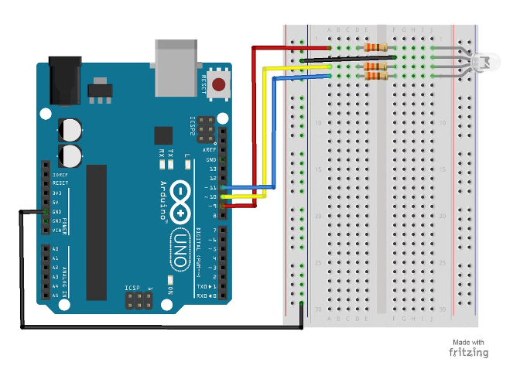
Components and Wiring
Arduino Uno
The Arduino Uno serves as the microcontroller, processing the input from the photoresistor and controlling the LED headlights accordingly.
Photoresistor
The photoresistor is responsible for detecting the ambient light levels and providing this information to the Arduino for analysis and headlight adjustment.
TIP122 Transistor
The TIP122 Darlington transistor acts as a switch, allowing the Arduino to control the intensity of the LED headlights based on the ambient light conditions.
LED Headlights
The system utilizes an array of 12V LED headlights, which can be adjusted in brightness to provide the optimal illumination for the current lighting environment.

Slide 6

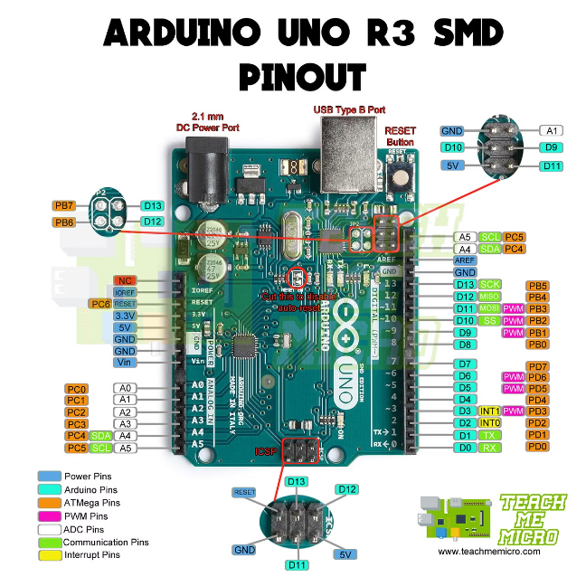



Photoresistor Circuit Wiring
Photoresistor to 5V
Connect one end of the photoresistor to the 5V pin on the Arduino.
Photoresistor to Analog Input
Connect the other end of the photoresistor to the A0 (analog pin 0) on the Arduino.
1k Ohm Resistor to Ground
Connect the other end of the 1k ohm resistor to the GND (ground) pin on the Arduino.

Slide 7


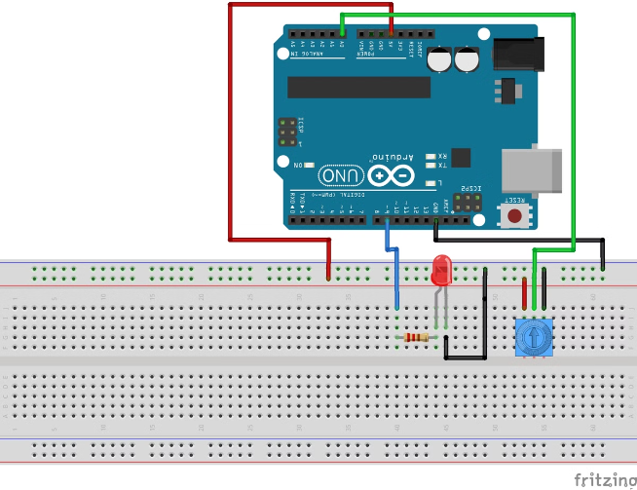


LED Headlight Circuit
Arduino Connection
Connect pin 11 of the Arduino to the base of the TIP122 transistor.
Transistor Configuration
Connect the Arduino ground to the emitter of the transistor, and the positive side of the battery to the collector of the transistor.
Power Source
Use a 9V battery as the power source, connecting the positive side to the LED headlight array and the negative side to the Arduino ground.

Slide 8

Potential Competitors and Target Customers
Competitors
Description
Major Automotive Manufacturers
Companies like BMW, Mercedes-Benz, Audi, and Volkswagen offer advanced headlight technologies, including adaptive and matrix LED headlights, as standard or optional features in their high-end vehicle models.
Aftermarket Headlight Suppliers
Suppliers like HELLA, Osram, and Philips provide adaptive headlight kits or retrofit solutions for existing vehicles, allowing for aftermarket installation.
Technology Startups
Smaller tech companies and startups may develop and market adaptive headlight systems as standalone products or as part of their vehicle automation or smart lighting solutions, often offering more affordable or customizable options.

Slide 9


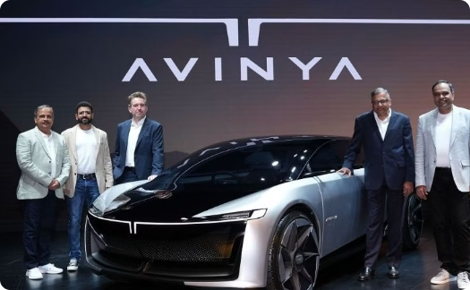
Target Customers
Maruti Suzuki
Hyundai
Tata Motors
As the largest car manufacturer in India, Maruti Suzuki could be a potential target customer for the Adaptive Automobile Headlight System, as it aims to enhance safety and customer satisfaction across its diverse vehicle lineup.
Hyundai, the second-largest car brand in India, is another potential target customer that could integrate the adaptive headlight technology into its vehicles to provide a premium driving experience for its customers.
Tata Motors, a prominent Indian automaker, could also be a target customer for the Adaptive Automobile Headlight System, as it aims to offer innovative and technologically advanced features in its growing vehicle lineup.

Slide 10
Pricing Comparison of Adaptive Automobile Headlight System
The Adaptive Automobile Headlight System offers a more affordable alternative to high-end luxury vehicle headlight solutions. While premium brands like BMW charge around ₹70,000 per headlight, our system can be implemented for a total estimated cost ranging from ₹4,110 to ₹10,220, including components, labor, and installation.
Component
Cost Range
Arduino Uno or Equivalent Microcontroller
₹500 - ₹1,000
TIP122 Transistor
₹50 - ₹100
Photoresistor
₹50 - ₹100
1k Ohm Resistor
₹10 - ₹20
LED Headlights
₹2,000 - ₹5,000
Wiring, Connectors, and Miscellaneous
₹500 - ₹1,000
Labor and Installation
₹1,000 - ₹3,000
This cost breakdown demonstrates the significantly lower pricing of our Adaptive Automobile Headlight System compared to high-end luxury vehicle options, making it an accessible solution for a wider range of automotive manufacturers and their customers.

Slide 11
Adaptive Automobile Headlight System: Cost Savings and Benefits
The Adaptive Automobile Headlight System offers a significantly more affordable alternative to high-end luxury vehicle headlight solutions. While premium brands like BMW charge around ₹70,000 per headlight, our system can be implemented for a total estimated cost ranging from ₹4,110 to ₹10,220, including components, labor, and installation.
This cost comparison demonstrates up to an 85% reduction in expenses compared to the BMW 7 Series G11 Adaptive LED Headlight, making the Adaptive Automobile Headlight System an accessible and cost-effective solution for a wide range of automotive manufacturers and their customers.
Key Benefits of Our System:
Affordable: Significantly lower cost than current market offerings.
Customizable: Tailored to individual vehicle requirements.
DIY Friendly: Accessible for automotive enthusiasts and hobbyists.

Slide 12
Conclusion:
The adaptive automobile headlight project presents a cost-effective solution to improve road safety and driving comfort. While facing challenges like sensor accuracy, the system offers enhanced safety, energy efficiency, and customization options at a fraction of the price of high-end luxury offerings.
Our adaptive headlight system demonstrates the potential of integrating advanced technology into automotive systems to address real-world challenges and enhance the driving experience for a wider range of customers.

